Slide 1
Swift – Collection Types

Slide 2
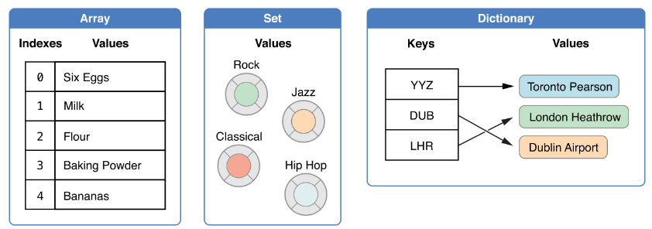
Three Collection Types

Slide 3
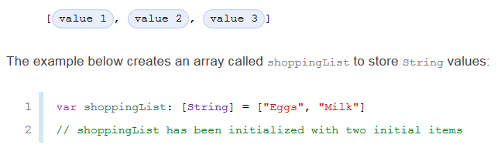
Array
Creating an Array with Array Literal

Slide 4
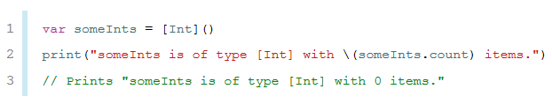
Arrays
Creating an Empty Array

Slide 5

Arrays
Creating an Array with a Default Values

Slide 6
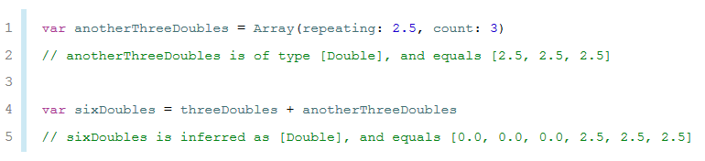
Array
Creating an Array by Adding Two Arrays

Slide 7

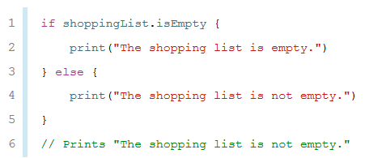
Accessing and Modifying an Array
Count
isEmpty

Slide 8

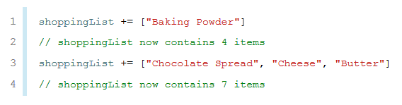
Accessing and Modifying an Array
Append

Slide 9



Accessing and Modifying an Array
Retrieve and Change

Slide 10
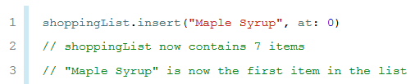
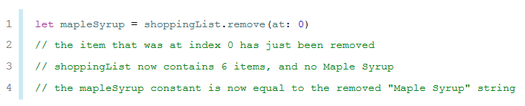
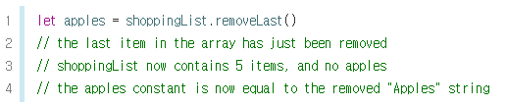
Accessing and Modifying an Array
Insert and Remove

Slide 11
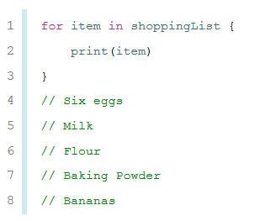
Iterating Over an Array

Slide 12
Sets
동일한 유형의 값들을 순서 없이 저장
NSSet 과 호환

Slide 13
Hash Values for Set Types
Swift의 기본 유형 모두 가능
String, Int, Double, Bool

Slide 14
Set Type Syntax
Set<Element>
Element는 set에 저장하려고 하는 데이터의 타입

Slide 15
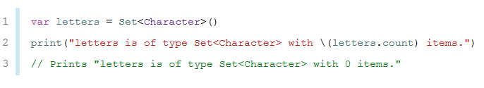
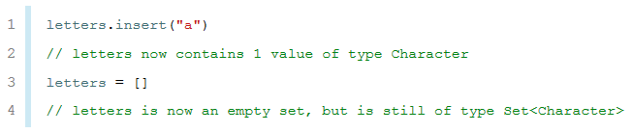
Creating and Initializing an Empty Set

Slide 16

Creating a Set with an Array Literal

Slide 17

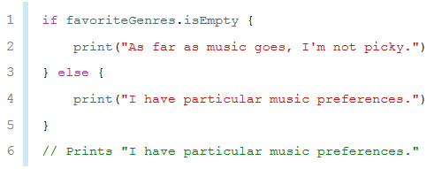
Accessing and Modifying a Set
메서드와 프라퍼티를 이용하여 접근/수정

Slide 18
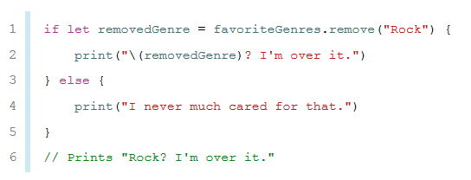
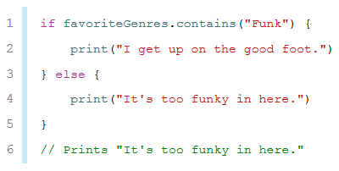
Accessing and Modifying a Set
메서드와 프라퍼티를 이용하여 접근/수정

Slide 19
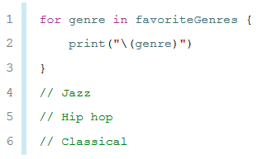
Iterating Over a Set

Slide 20
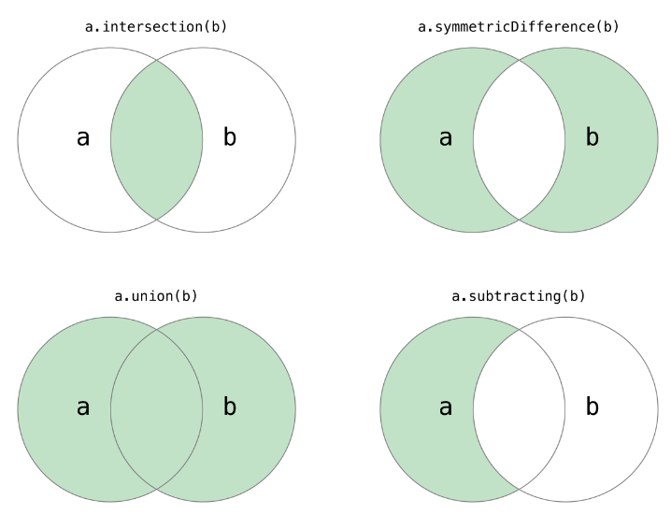
Performing Set Operations
Fundamental Set Operations

Slide 21
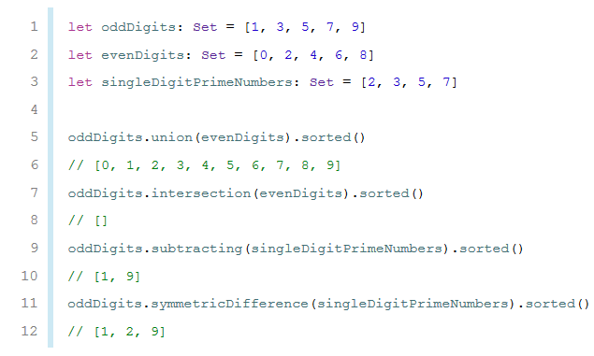
Performing Set Operations
Fundamental Set Operations

Slide 22
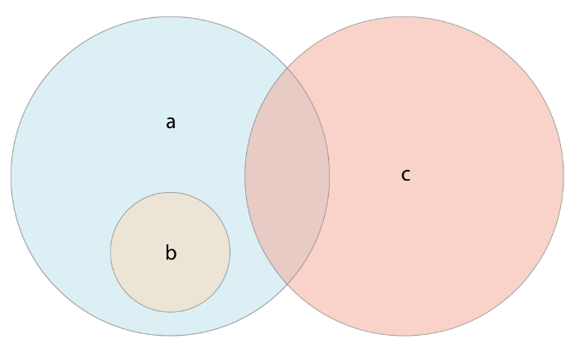
Performing Set Operations
Set Membership and Equality
==
issubset(of: )
isSuperset(of: )
isStrictSubset(of: )
isStrictSuperset(of: )
isDisjoint(with: )

Slide 23
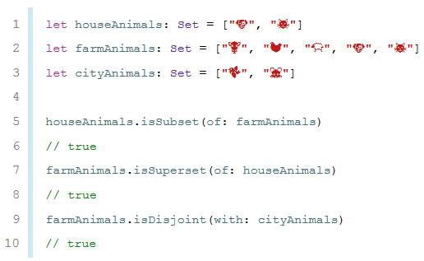
Performing Set Operations
Set Membership and Equality

Slide 24
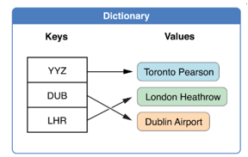
Dictionary
Keys and values
NSDictionary class
Dictionary type Shorthand Syntax
Dictionary<Key, Value>

Slide 25

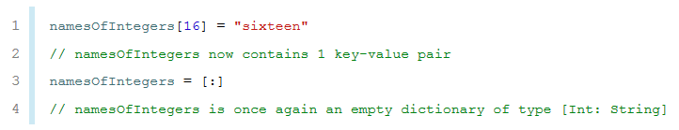
Creating an Empty Dictionary

Slide 26
Creating a Dictionary with a Dictionary Literal
key-value pair

Slide 27

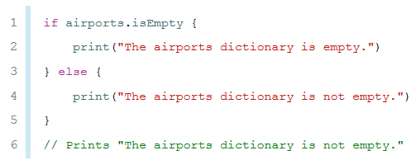
Accessing and Modifying a Dictionary
메소드와 프라퍼티를 이용하여 접근/수정

Slide 28


Accessing and Modifying a Dictionary
추가/수정

Slide 29
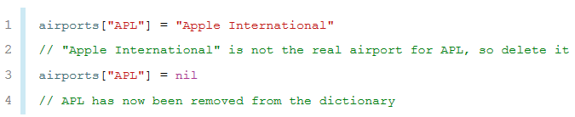
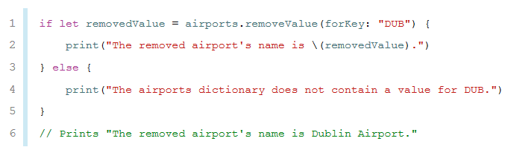
Accessing and Modifying a Dictionary
삭제

Slide 30
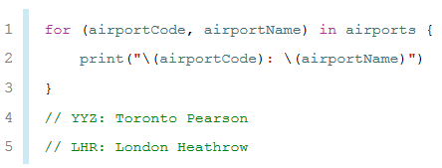
Iterating Over a Dictionary

Slide 31
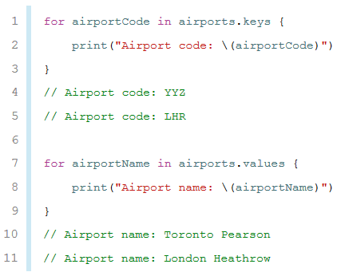
Iterating Over a Dictionary

